Slide 1
Gov Docs for Genealogy!
An Overview of Free Instructional and Informational Government WebSites for Genealogists

Slide 2
Do many Government agencies have genealogical information?

Slide 3
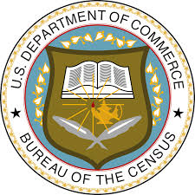
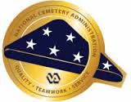

Slide 4
Navigating NARA (National Archives and Records Administration
Few actual records
Records digitized by NARA partners may later be discoverable in the NARA catalog
Strong on instructional information
Great online classes

Slide 5
Records digitized by digitization partners
NARA cannot digitize all their records
They partner with sites like Ancestry, Fold3, and FamilySearch to make digitization happen
Each partner signs a digitization agreement
The agreement outlines the length of the embargo period during which only the partner can make the digital images available
After an embargo period has expired, the images can be searched and viewed in NARA’s catalog

Slide 6
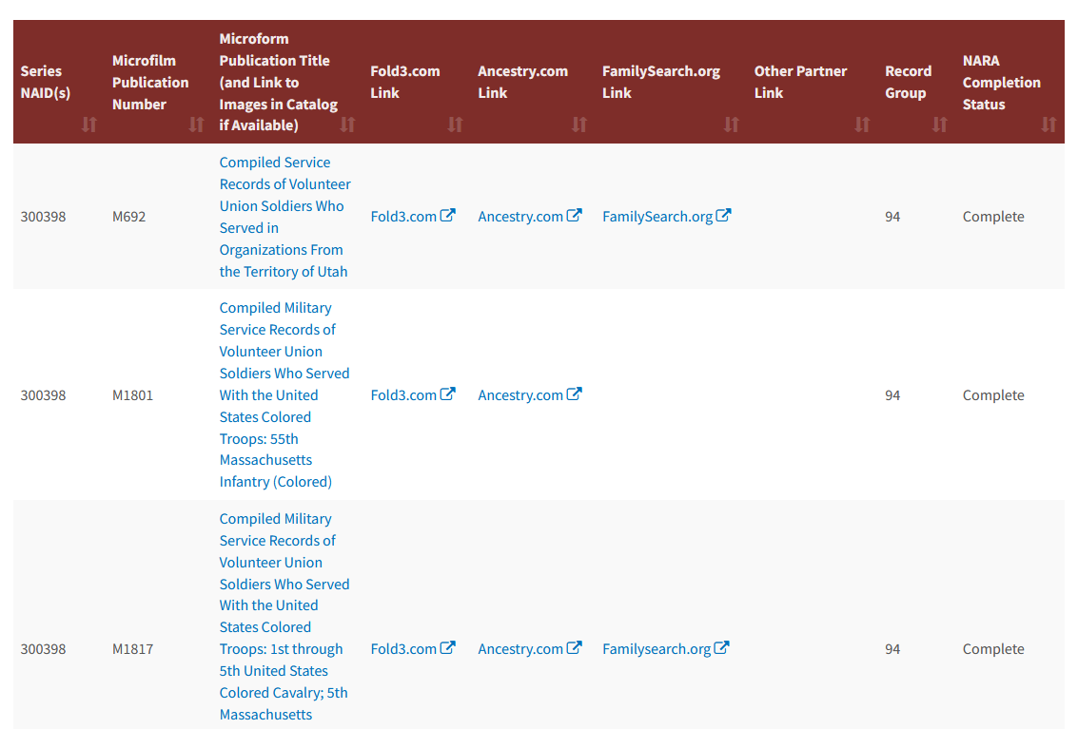

Slide 7
Locating Records in the Nara Catalog

Slide 8
Fold3 vs. NARA

Slide 9
Instructional Info at NARA
Virtual Genealogy Fair
Free online classes that you can stream live or watch later. Hasn’t been held in recent years but they continue to offer online classes.
Know Your Records Program
Online classes taught by NARA staff. Available on YouTube.
Prologue
Official publication of the National Archives

Slide 10
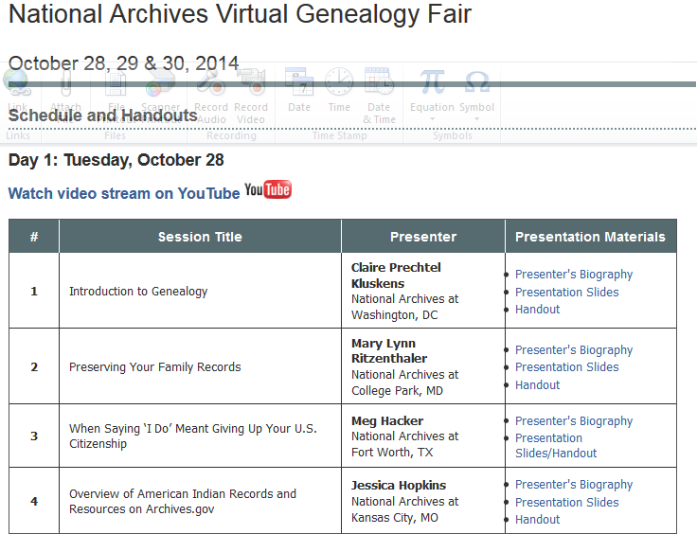
Virtual Genealogy Fair

Slide 11
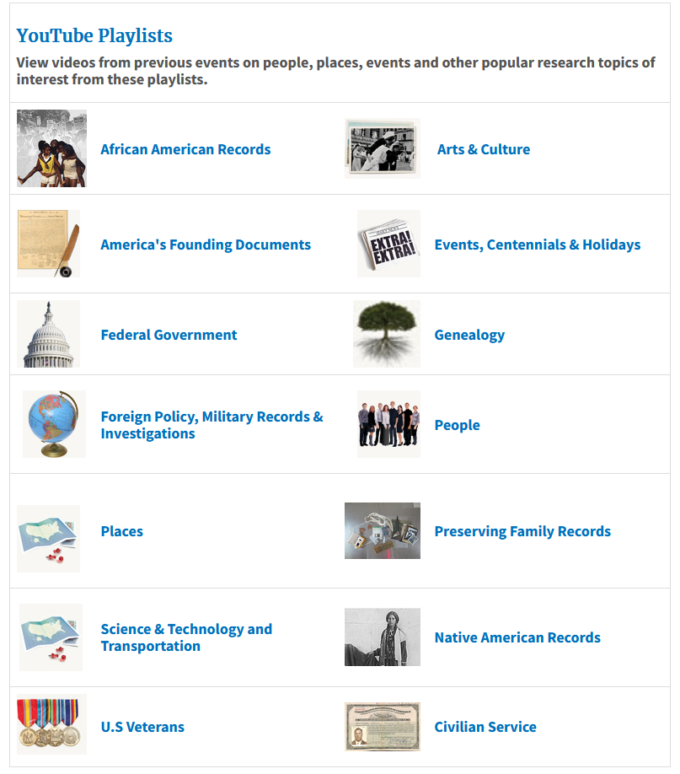
Know Your Records Program

Slide 12
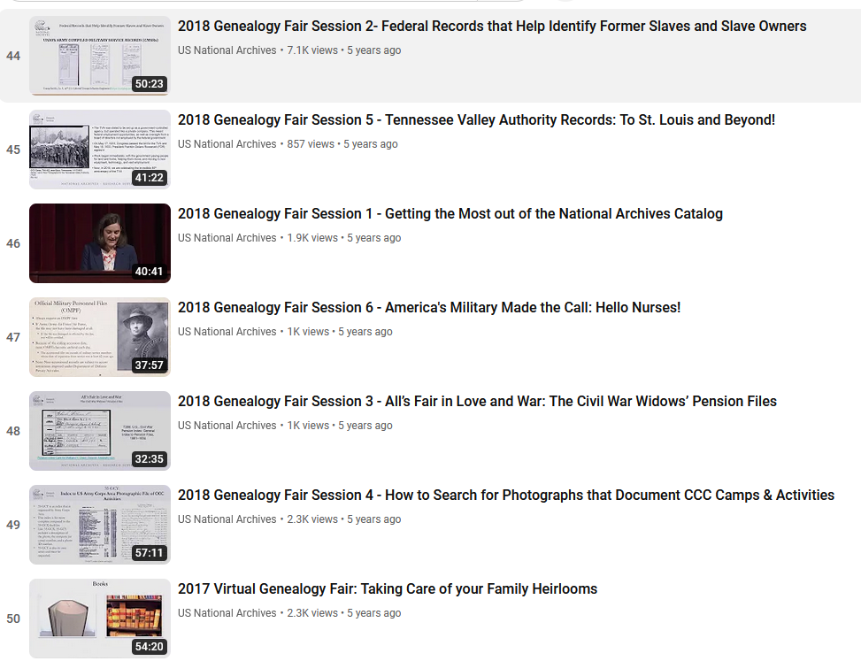

Slide 13
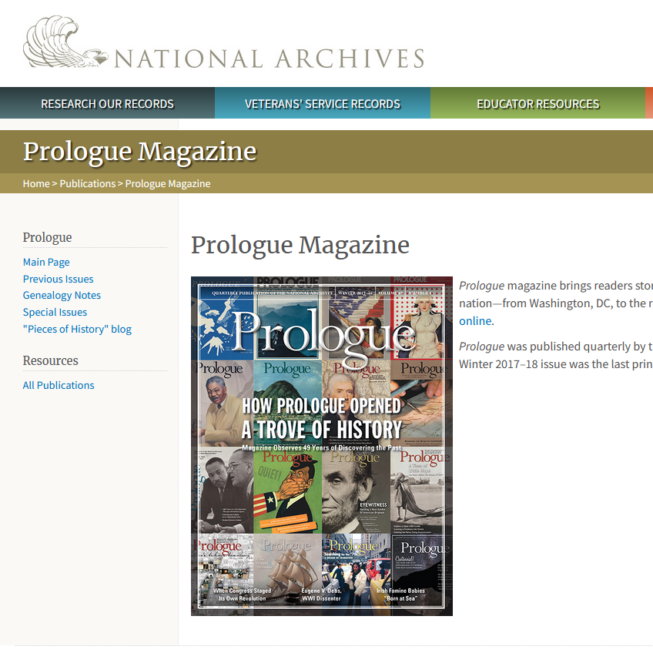
Prologue Magazine
Select articles online as far back as 1973
Published quarterly
Ceased publication with the Fall/Winter 2017-2018 issue

Slide 14
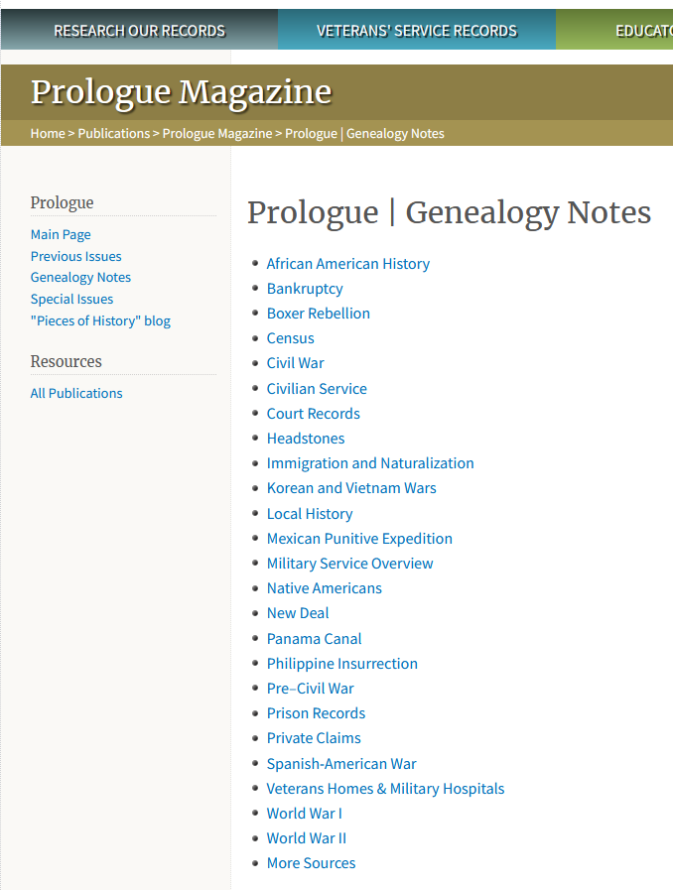
Genealogy Notes
Arranged alphabetically by subject
Links to articles that appeared in previous issues.

Slide 15
NPS Civil War Soldiers and Sailors Database
Created by the National Park Service with help from the Genealogical Society of Utah and the Federation of Genealogical Societies
Indexes over 6.3 million soldier records from 44 states and territories
Does not include copies of service records
Includes names and burial information for soldiers buried in a National Cemetery (still being updated)
Search for Medal of Honor recipients and prisoners of war

Slide 16
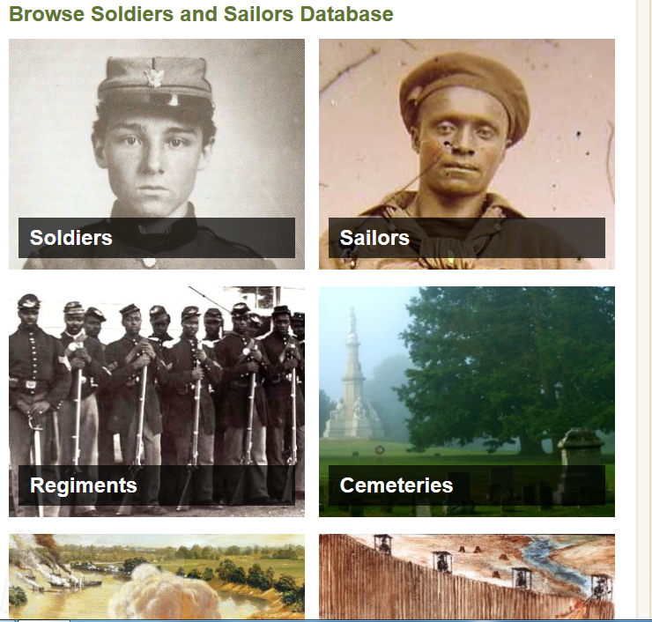

Slide 17
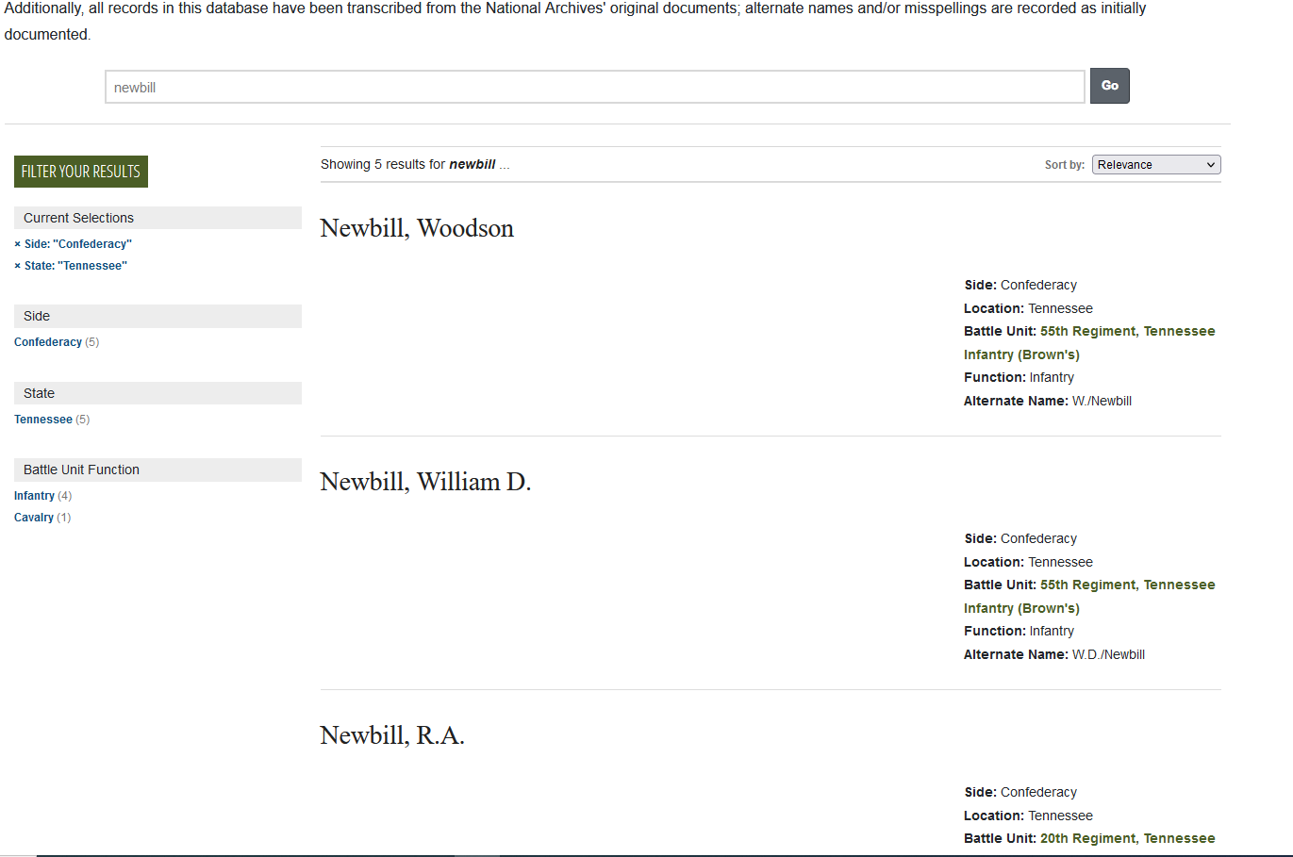

Slide 18
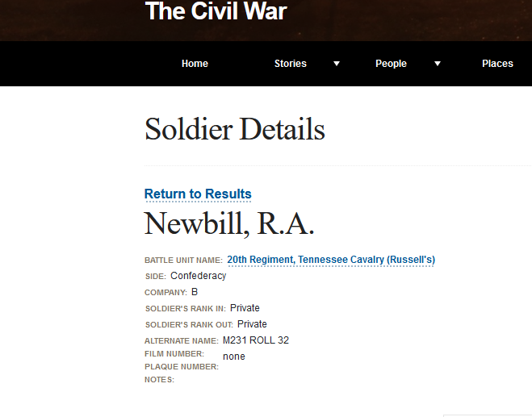

Slide 19
Bureau of Land Management, General Land Office
Search over 5 million Federal land titles issued between 1820 and the present.
Only includes the public land states (states created out of the public domain after the Revolutionary War)
Includes military warrant patents

Slide 20
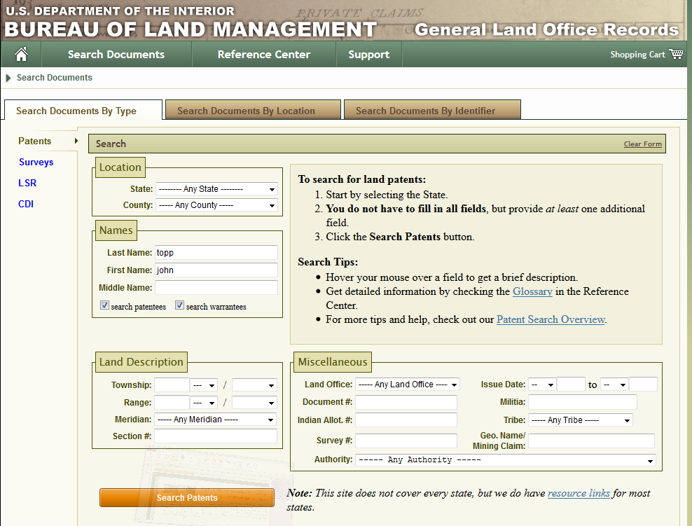

Slide 21
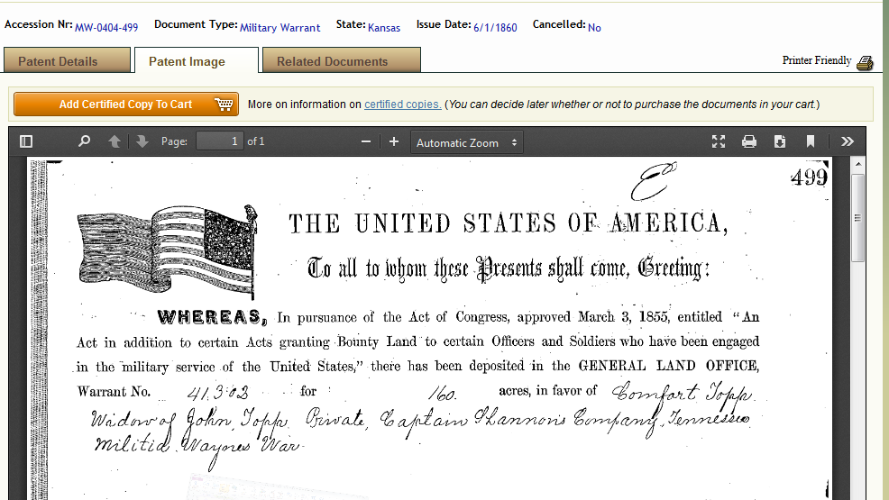

Slide 22
Chronicling America: historic American Newspapers
A database of historic newspapers from the Library of Congress
Provides key word searching of hundreds of newspapers from all over the country
Full text is available
Also provides a comprehensive directory of newspapers published in the U.S. from 1690-present and information about their holdings

Slide 23
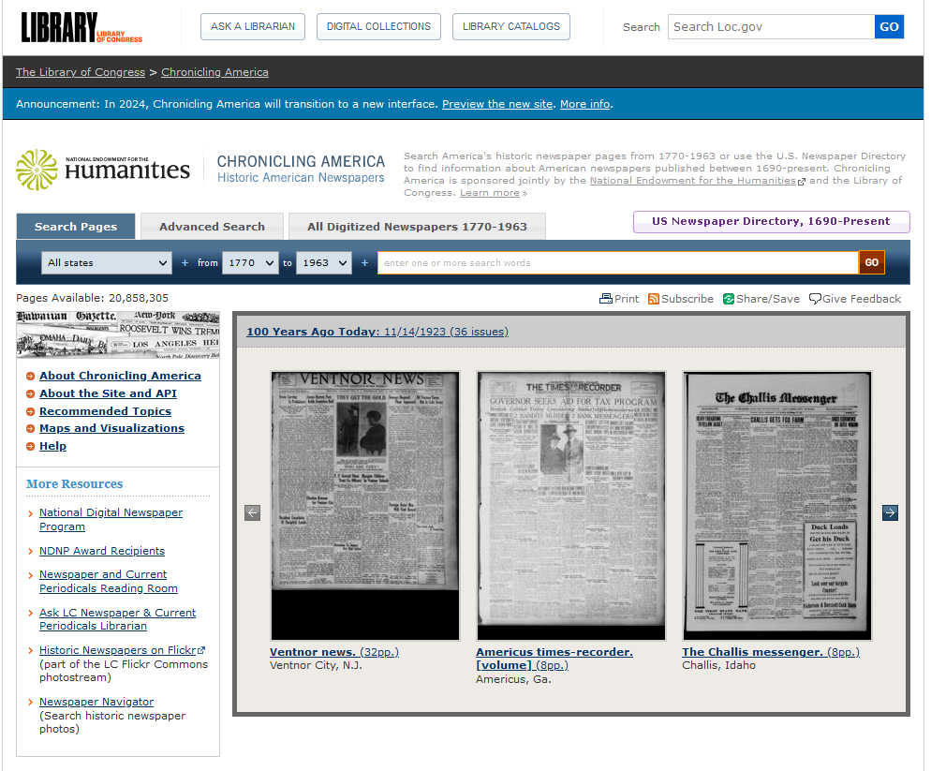

Slide 24
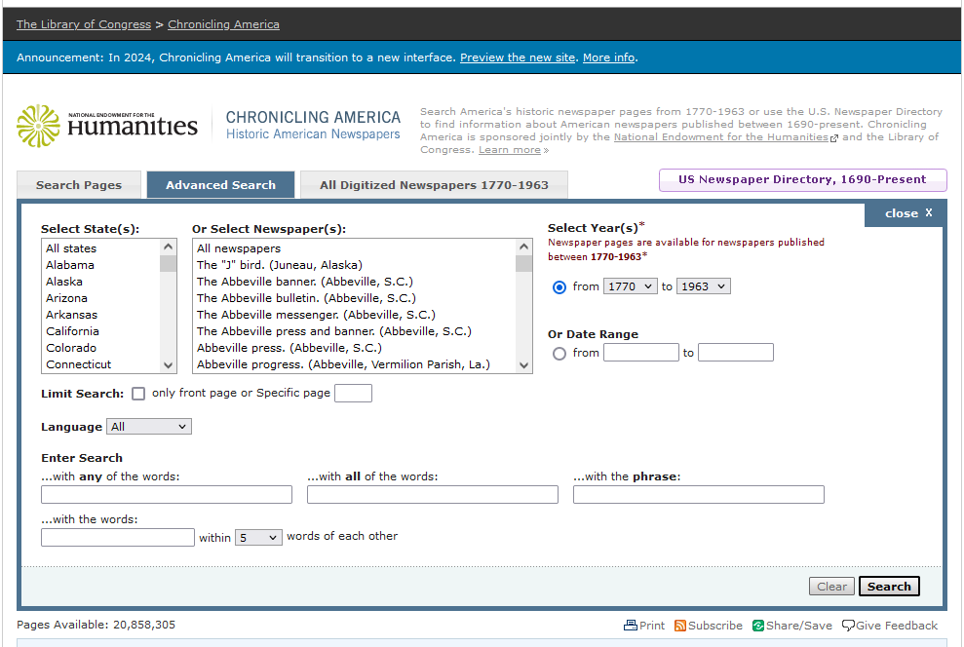

Slide 25
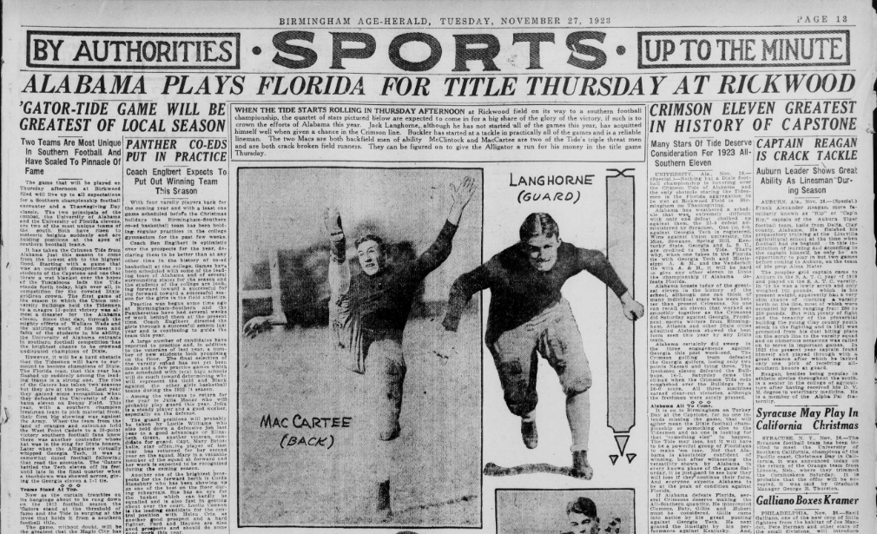

Slide 26
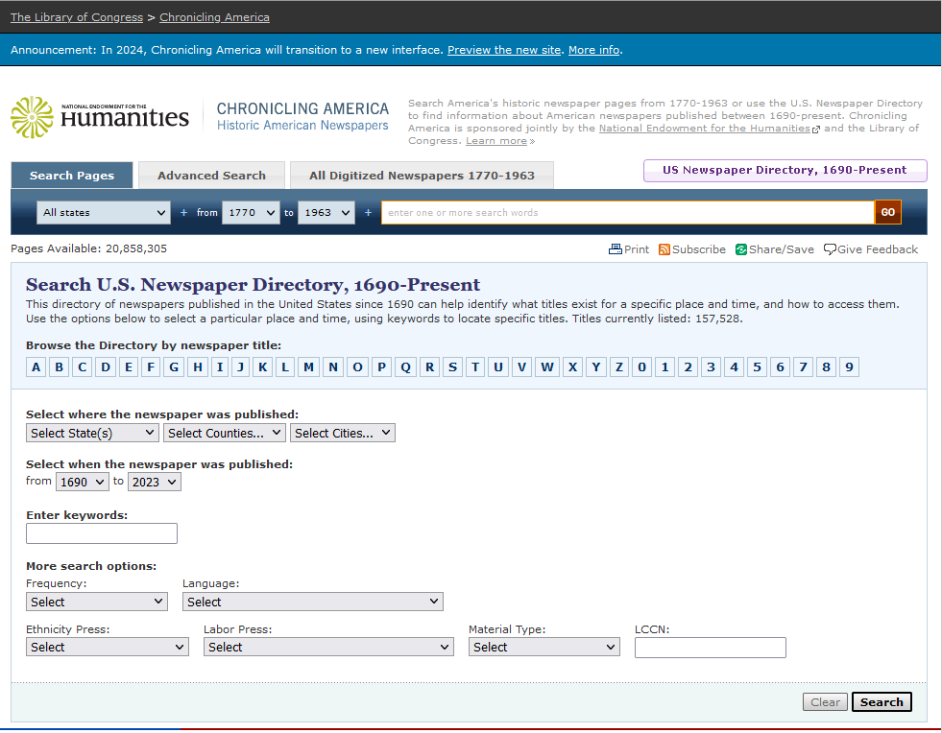

Slide 27
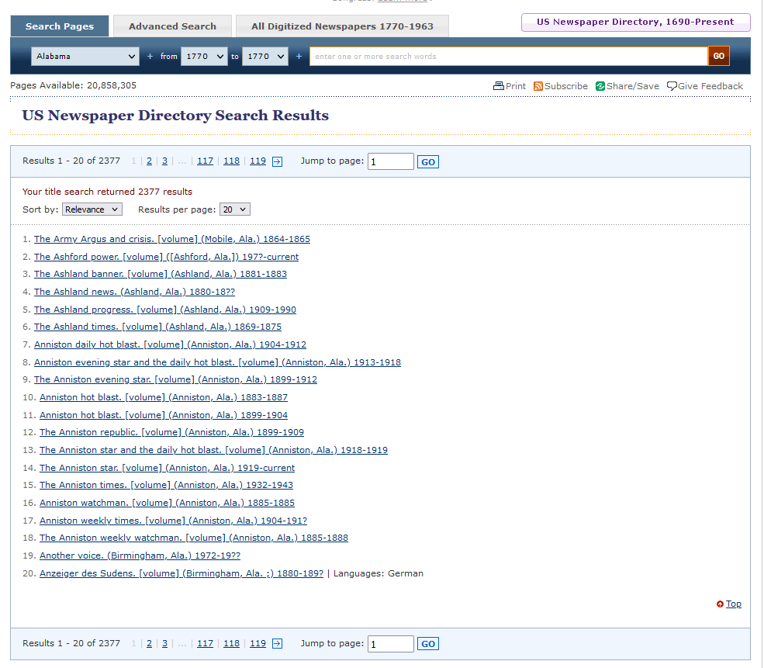

Slide 28
But that’s not all . . .
Unexpected Government sites for the genealogist

Slide 29
Historic Jamestown
From the National Park Service
Contains maps, books, and articles about recent excavations, the Jamestown settlement, and the Native American population at the time of settlement.
Documentary History of Jamestown Island, Vol. III
This volume, prepared by the National Park Service for the 400th Anniversary of Jamestown includes brief biographies of persons who, “played some sort of role in Jamestown Island’s history and was mentioned in one or more primary sources used in determining land ownership patterns.” (p.1)
Entries are arranged alphabetically and there is also an index

Slide 31
Documentary History of Jamestown Island, vol. III

Slide 32
The National Cemetery Administration
National cemeteries were first developed in the United States during the Civil War. Due to mounting war casualties, on July 17, 1862, Congress empowered President Abraham Lincoln, “to purchase cemetery grounds and cause them to be securely enclosed, to be used as a national cemetery for the soldiers who shall die in the service of the country.”
The NCA maintains approximately 3.4 million gravesites at 131 National Cemeteries in 40 states (and Puerto Rico)
Burial in a national cemetery is open to all members of the armed forces and Veterans who have met minimum active duty service requirements and were discharged under conditions other than dishonorable.
VA will provide – at no cost to the Veteran’s family – a gravesite, headstone or marker, Presidential Memorial Certificate, U.S. flag, perpetual care of the gravesite and will open and close the grave.

Slide 33
Nationwide gravesite locator
Database of burials is updated each day
Search for burial locations of veterans and their family members in VA National Cemeteries, state veterans’ cemeteries, various other military and Department of Interior cemeteries, and for veterans buried in private cemeteries when the grave is marked with a government grave marker.

Slide 34
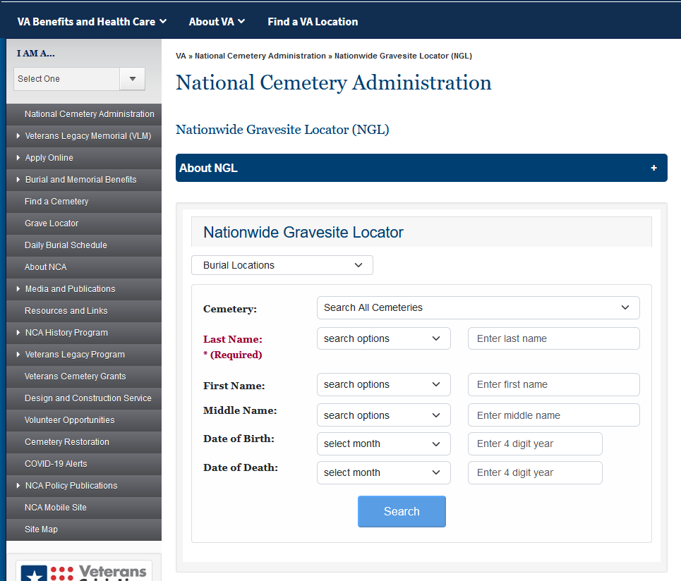

Slide 35
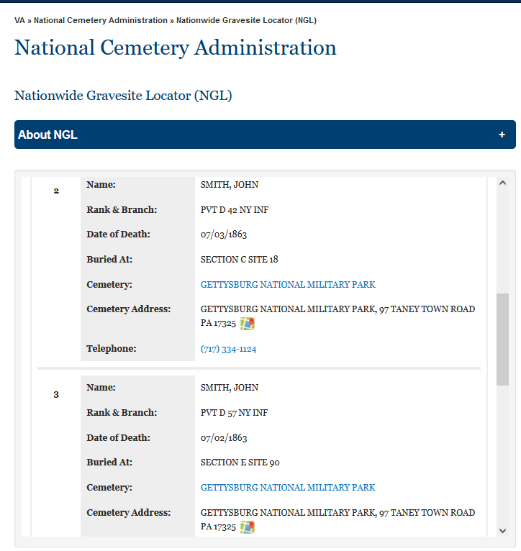

Slide 36
Official Register of the United STates
Published roughly every two years by the Federal Government from 1816-1959
Lists the name, place of birth, location of appointment, and annual salary for many federal employees and military officers
Many are online at google books or hathitrust.com
Know Your Records video on YouTube about the Official Register

Slide 37
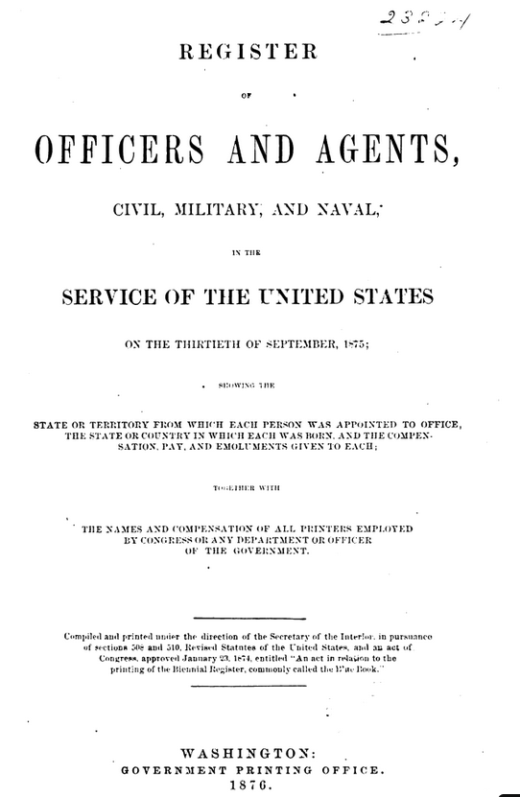

Slide 38
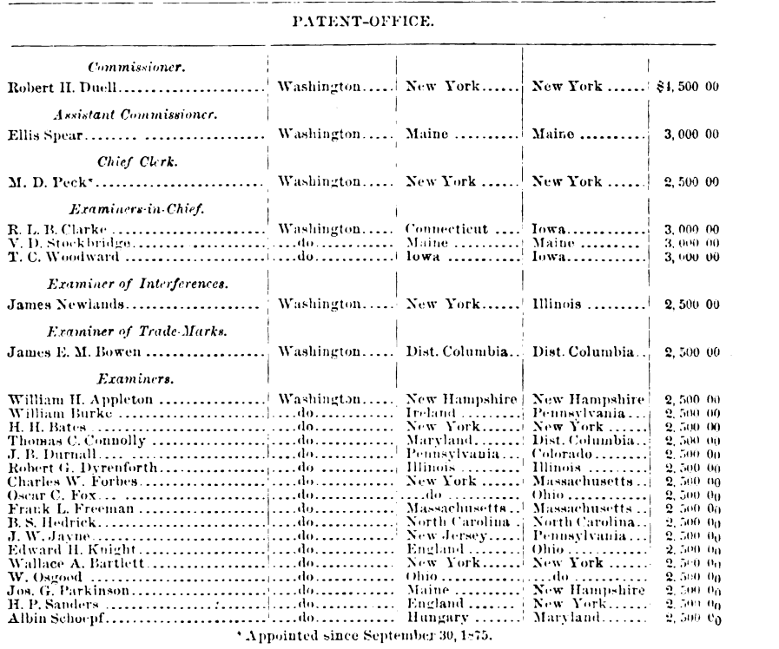
Patent Office
Employees in
1875

Slide 39
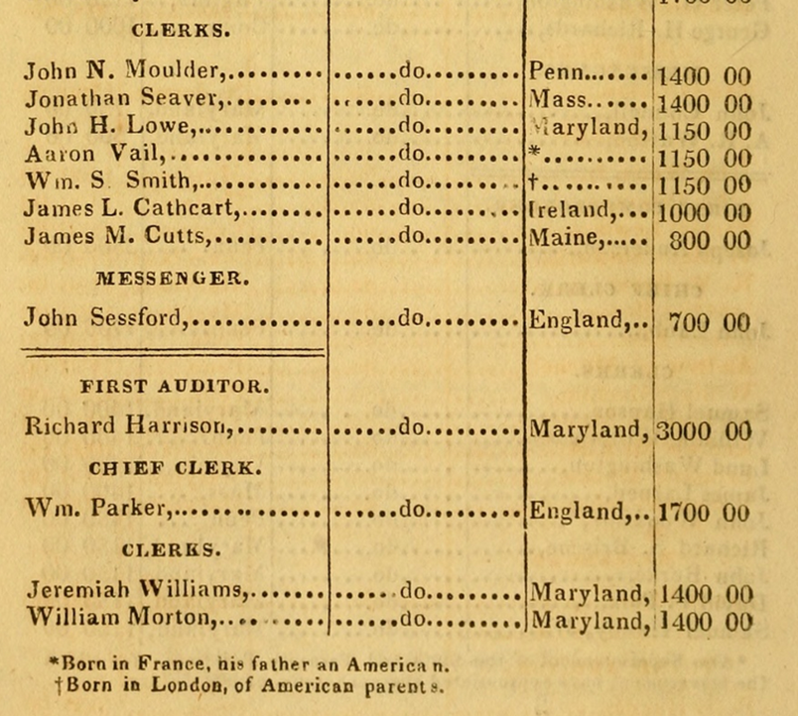
In 1825 two clerks in the Treasury Department, Aaron Vail and William S. Smith have a special notation about their birthplace and the nationality of their parents.

Slide 40
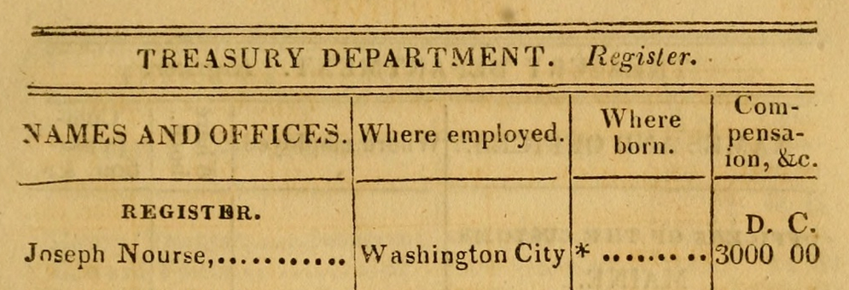
Joseph Nourse, the first Register for the Treasury, was actually born in England but came to America with his parents in 1769.

Slide 41
Patents as Genealogy Resources
Patents can aid family historians in numerous ways:
They not only give the inventor’s name but also their hometown
An image of his or her signature
If an inventor has multiple patents, you may be able to track their movement over time
Investigate the witnesses. They could be relatives.
You may learn the name of an ancestor’s employer
If they were citizens of another country at the time, this may be indicated on the patent
Use them to further complete the picture of your ancestor.

Slide 42
Patents as Genealogy Resources
Search patents online
The USPTO’s search tool is called Patent Public Search
Google Patents offers an easy, familiar interface
This is not a full-blown prior art search.
We’re just having fun.

Slide 43
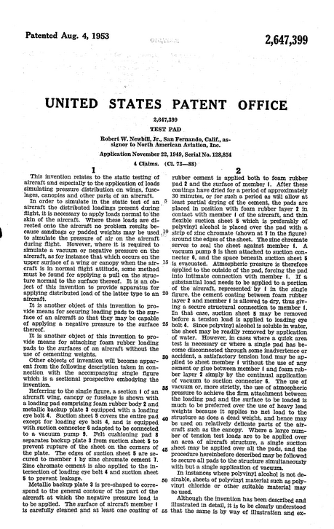
Patent number 2,647,399 was issued to Robert W. Newbill, Jr. on August 4, 1953.
He lived in San Fernando, CA and worked for North American Aviation, Inc.

Slide 44
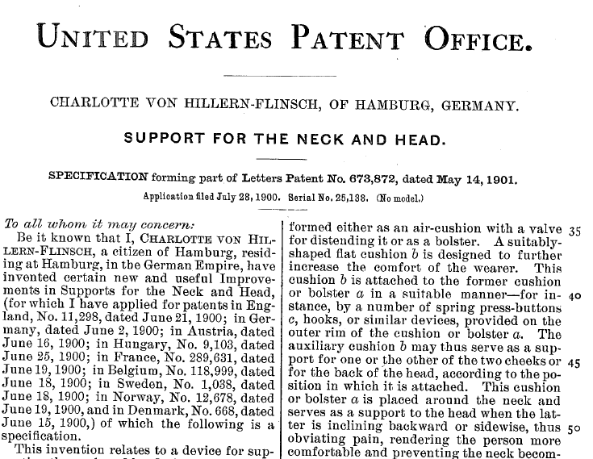
Don’t just look for American ancestors.
Citizens of other countries applied for U.S. Patents.
Charlotte von Hillern-Flinsche invented a neck pillow.
She lived in Hamburg, Germany and applied for patents all over the world.

Slide 45
Think local
State and local governments also have some great sites with genealogical info.

Slide 46
Founded in 1901, the ADAH was the first state archives in the U.S.
Includes several online databases
Digital Collections
Finding aids for church and synagogue records
Lists of newspapers available at ADAH or on microfilm

Slide 47
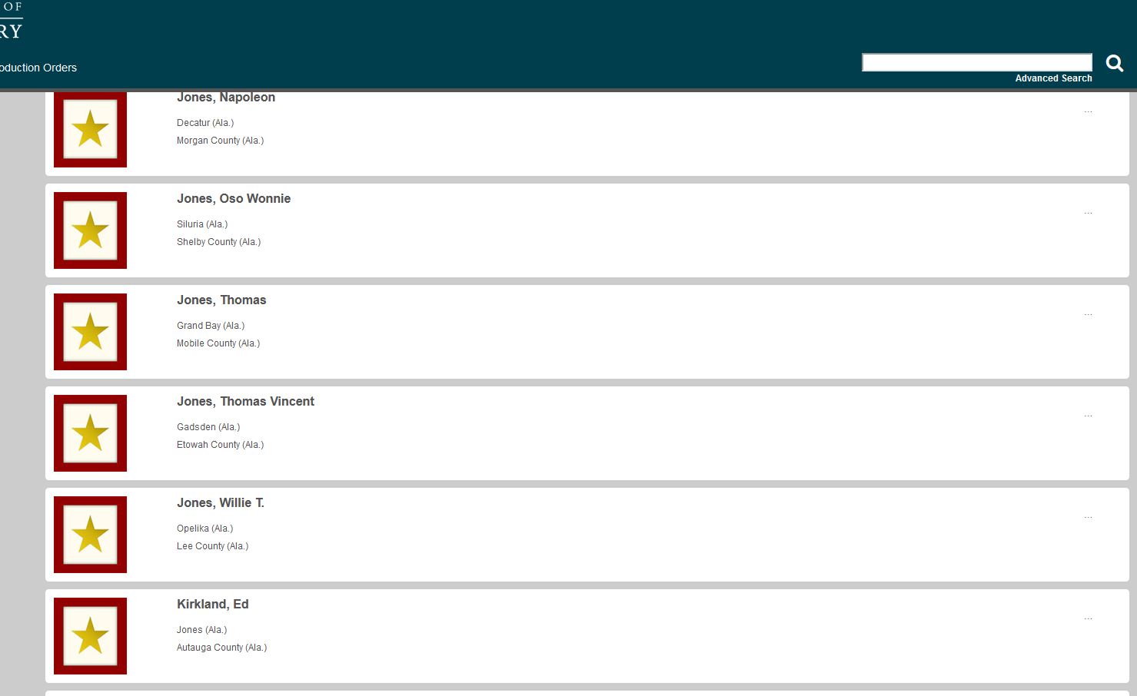

Slide 48
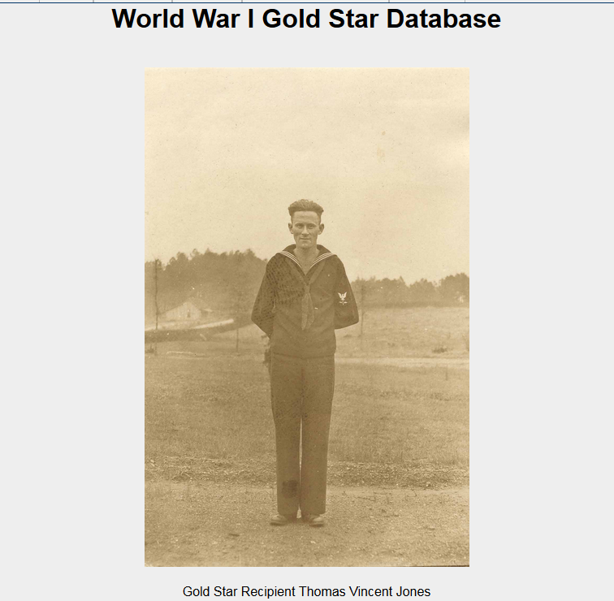

Slide 49
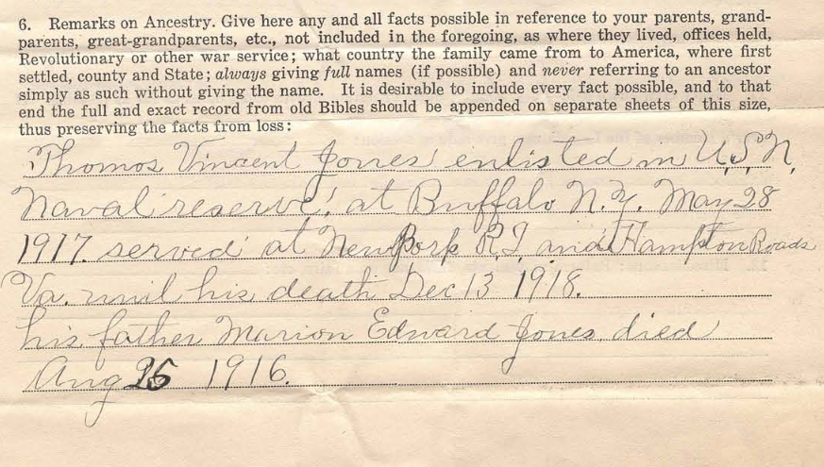
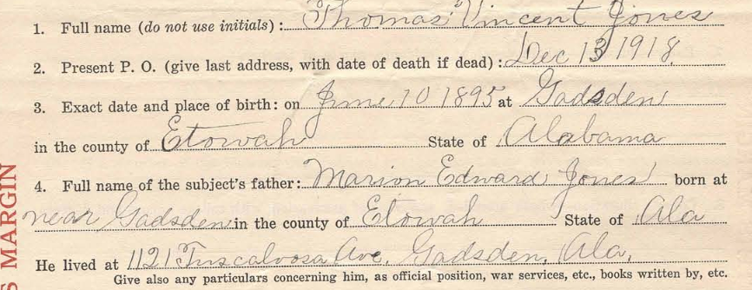
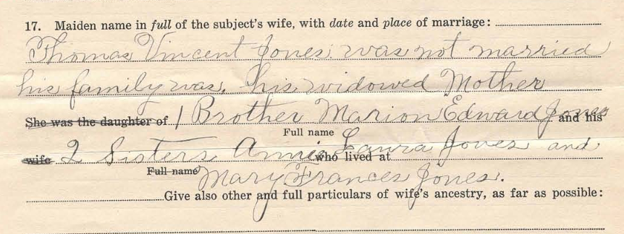

Slide 50
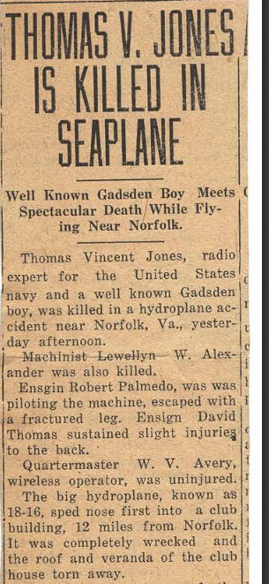
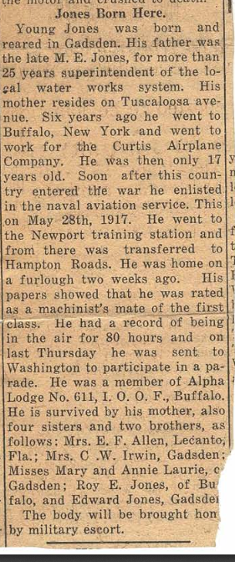

Slide 51
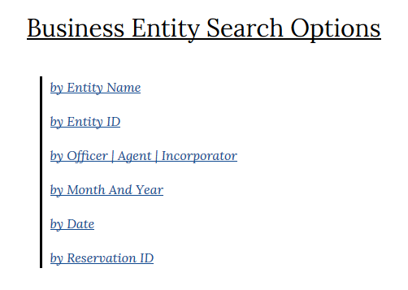
Alabama secretary of state Business Entity Search
Search by business name, location, officer or incorporator, and date. Non-profit entities are also included in the database.

Slide 52
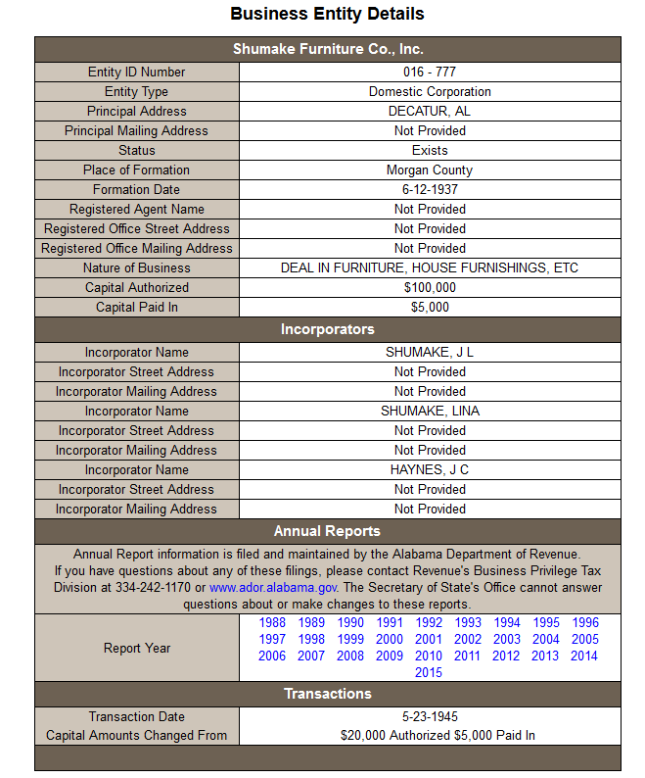
Provides names of incorporators
Place of formation
Date of formation
Nature of business
Annual reports or other
documentation can be ordered
from the Secretary of State’s
Office.

Slide 53
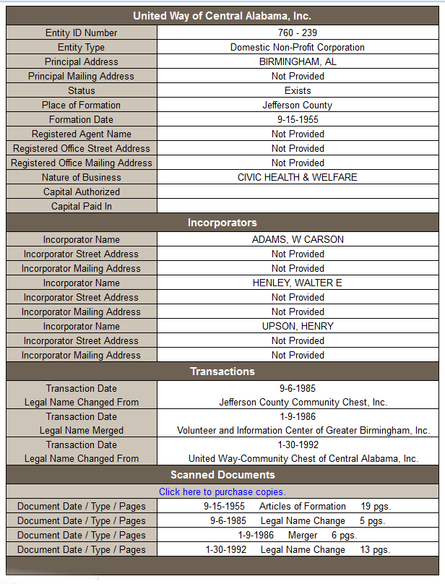
Entries for non-profits provide much the same information as the business entries do.

Slide 54
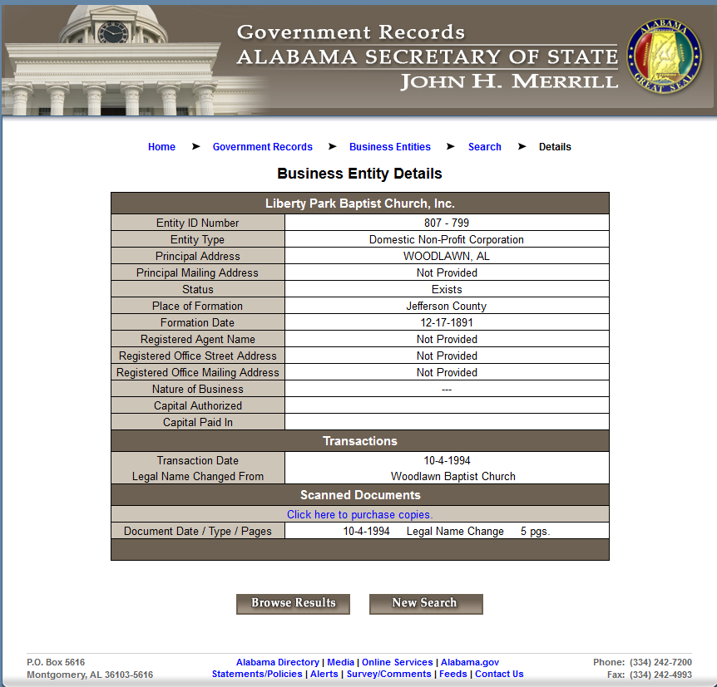

Slide 55
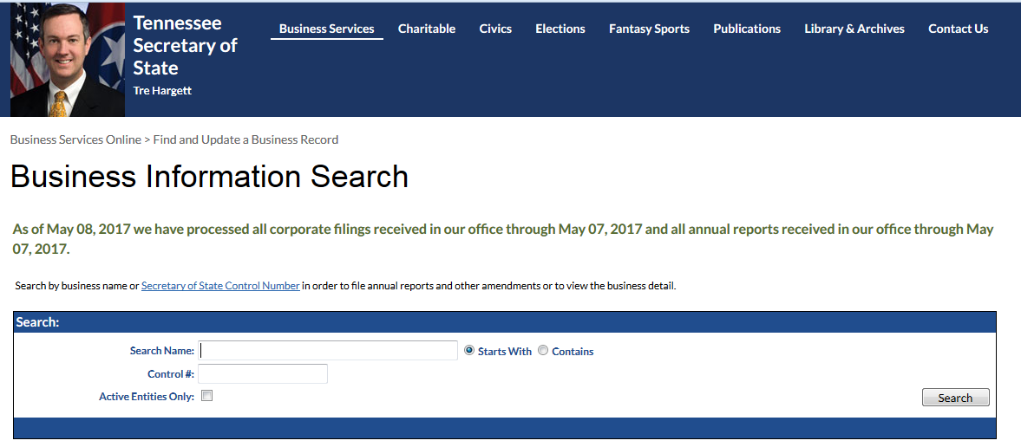
Tennessee Has ONe
Tennessee Has One

Slide 56
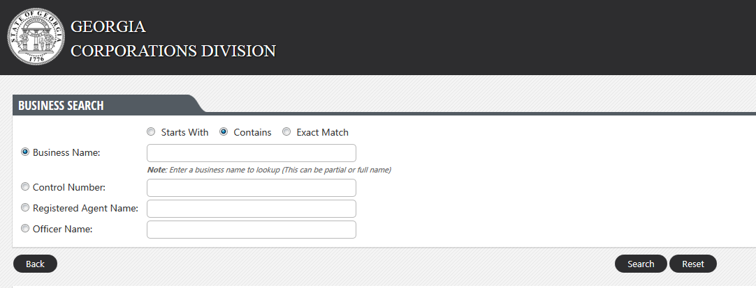
So Does Georgia
So Does Georgia

Slide 57
And Mississippi

Slide 58
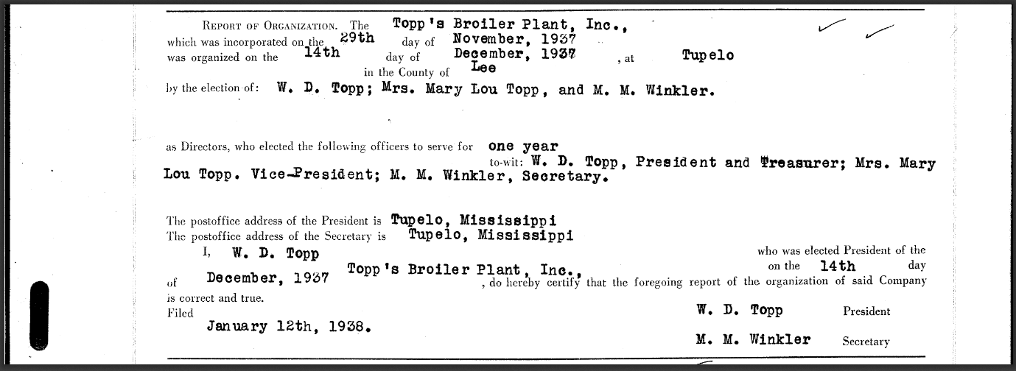

Slide 59
Take advantage of Government websites for genealogy. They’re fun and free.

Slide 60
Thanks for coming! Mary Beth newbill Birmingham Public Library Southern History Department mary.newbill@cobpl.org 205-226-3665

