Slide 1
NOAA: Navigating the Flood of Information
Kelly Marie Wilson
Social Sciences / Government Documents Librarian
Troy University

Slide 2
How many of you have used the NOAA website before today?
2

Slide 3
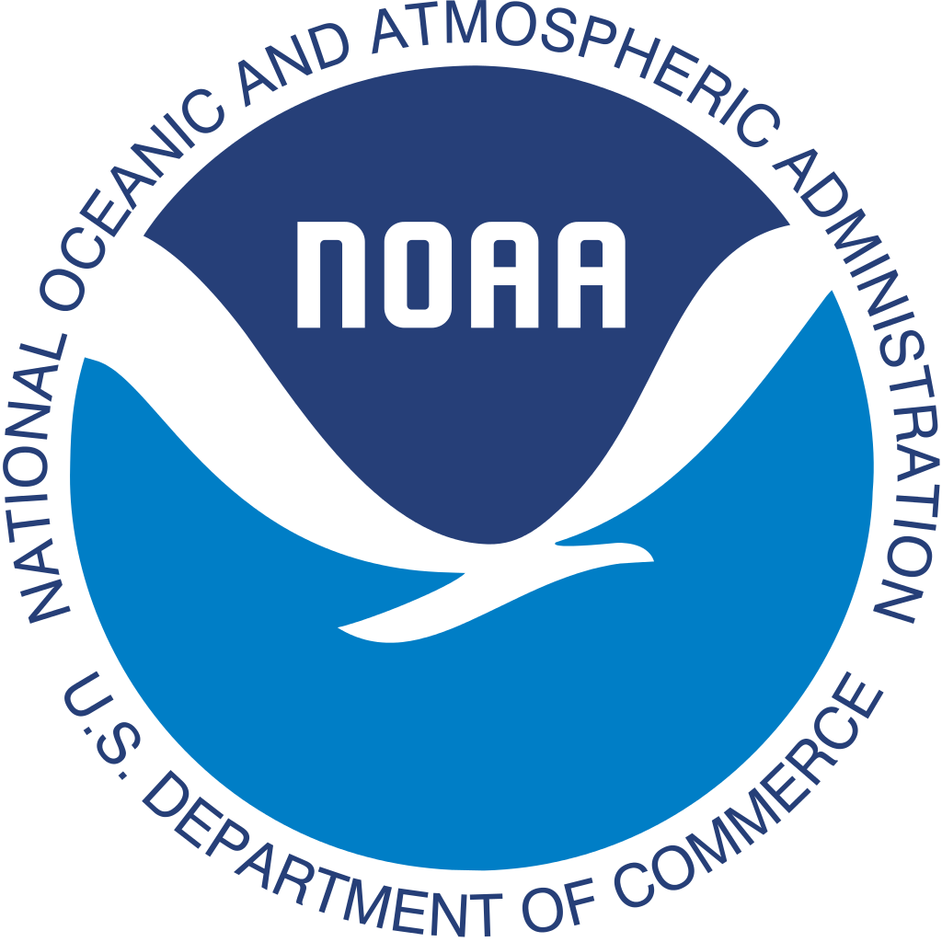
National Oceanic and Atmospheric Administration
Web site = https://www.noaa.gov
Governed by the U.S. Department of Commerce
NOAA turns 50 this year!!!!
NOAA’s site as a hub.
Weather.gov
Climate.gov
Fishwatch.gov

Slide 4
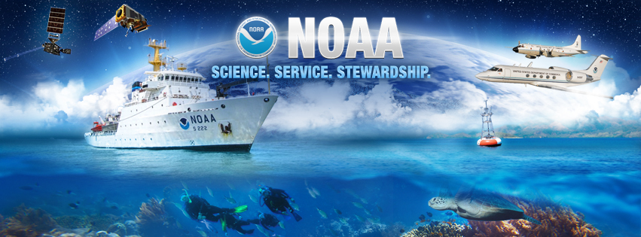
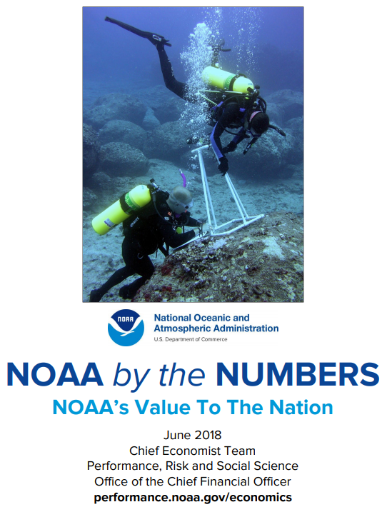
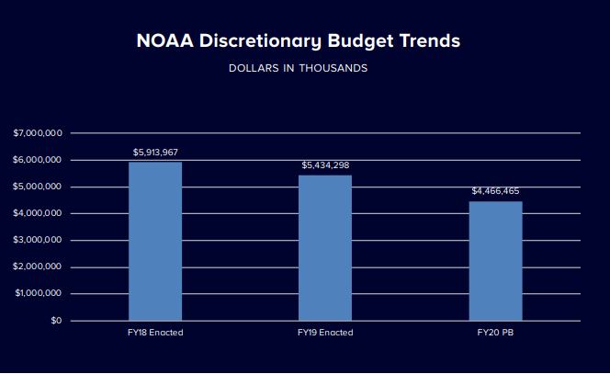
About NOAA…
NOAA’s Mission: Science, Service, and Stewardship.
NOAA’s Vision for the Future
Mission and Vision statements: https://www.noaa.gov/our-mission-and-vision
Organizational Chart
Budget & Reports
Statement on Value to Society
NOAA by the Numbers
Notes:
NOAA’s Mission: Science, Service, and Stewardship (they apparently forgot their Oxford Comma)
To understand and predict changes in climate, weather, oceans, and coasts;
To share that knowledge and information with others; and
To conserve and manage coastal and marine ecosystems and resources.
NOAA’s Vision for the Future:
Resilient Ecosystems, Communities, and Economies; and
Healthy ecosystems, communities, and economies that are resilient in the face of change.

Slide 5
NOAA’s Offerings
Weather.gov – National Weather Service – information on weather forecast, hurricanes, radars, thunderstorms, tornadoes, safety information, and much more!
Climate.gov -> Maps, Data, Resources for teaching about climate, news.
National Ocean Service -> Ocean facts, educational resources, podcasts, careers, ecosystems, and more.
Fisheries tracks marine life and environment, provides educational resources, information on protecting marine life, science, data, and permit information.
This page provides information on the NOAA satellites, news, imagery, data, and videos.
NOAA takes part in research initiatives around the U.S. and internationally. Information on research, labs, scientific reviews, and more can be found here.
This page provides information on the NOAA fleet, hurricane hunters, the NOAA Corps, and diving programs.
This section is more research-heavy, but here you can find various charts, publications, data tools & apps, and educational resources.
Here, you will find a super cool map of all the marine sanctuaries in the U.S. as well as information, history, educational resources, photos, videos, and virtual dives!
This section is where you will find resource collections for teaching about NOAA, opportunities for both students and educators, and grant funding opportunities.
Notes:
What does NOAA’s site offer?
Weather information, Climate information, Access to the latest research on NOAA, Resources for students and teachers, Grant Funding, And much more…
Fun fact: 95% of the ocean is still unexplored!

Slide 6
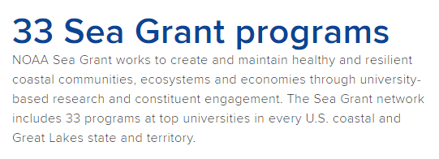
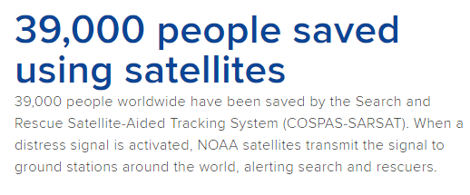
Fun Facts
The NOAA site is filled with fun and interesting facts that you can use for informational packets, displays, articles, etc. Here are a few:

Slide 7
Demo time!
noaa.gov

Slide 8
THANK YOU! Questions? Comments?
Upcoming FDLP Webinar: A Guided Tour of NOAA Climate.gov – Three Portals in One.
Date: Friday, Feb. 21, 2020
Time: 1:00 – 2:00 (Central)
Insert Image
Contact Information:
kwilson151343@troy.edu OR
kelly.m.wilson2011@gmail.com

